Slide 1
Windows Synchronisation Objects

Slide 2
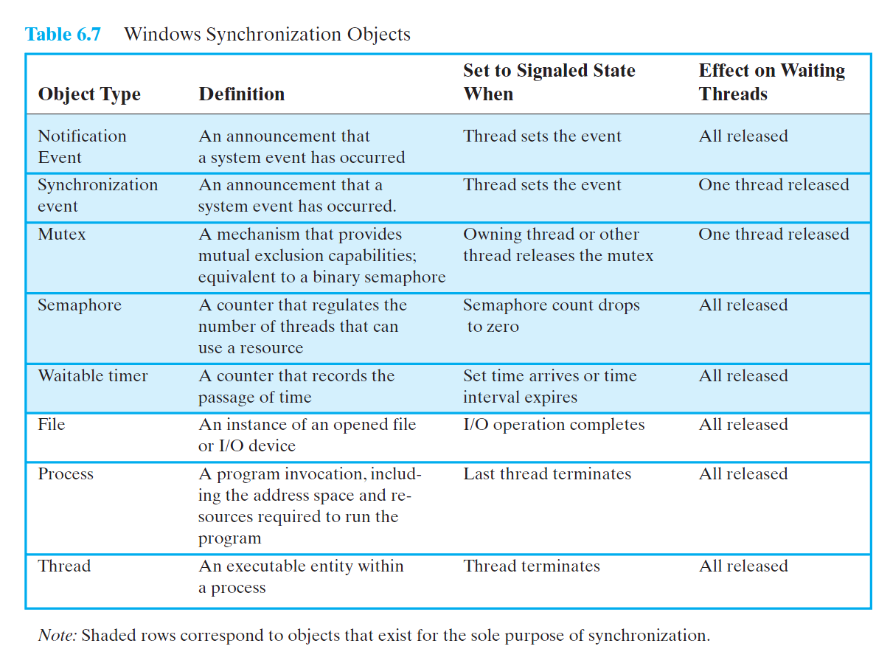
Stallings, Op. Sys., Ed. 6, Table 6.7, p. 300.

